Slide 1
Agriculture Related Career
Opportunities Workshop
January 13, 2015
Ruben Flores

Slide 2
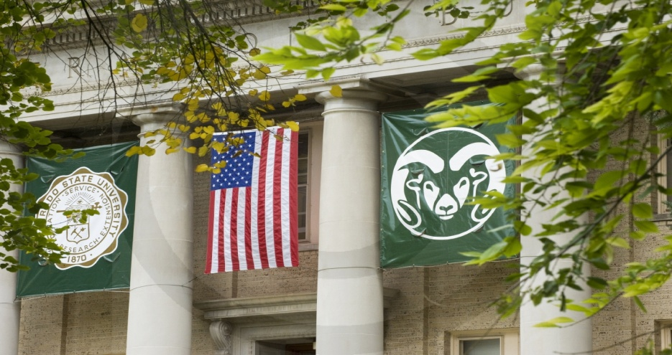
Colorado State University (CSU)
CSU was started in 1870 as the
Colorado Agricultural College
Colorado State College of Agriculture & Mechanic Arts (Colorado A&M) - 1935
Colorado State University - 1957

Slide 3
College of Agricultural Sciences (CAS)
CAS is one of eight Colleges at CSU
Other Colleges:
- Business
- Engineering
- Health & Human Sciences
- Liberal Arts
- Natural Resources
- Natural Sciences
- Veterinary Medicine & Biomedical Sciences

Slide 4
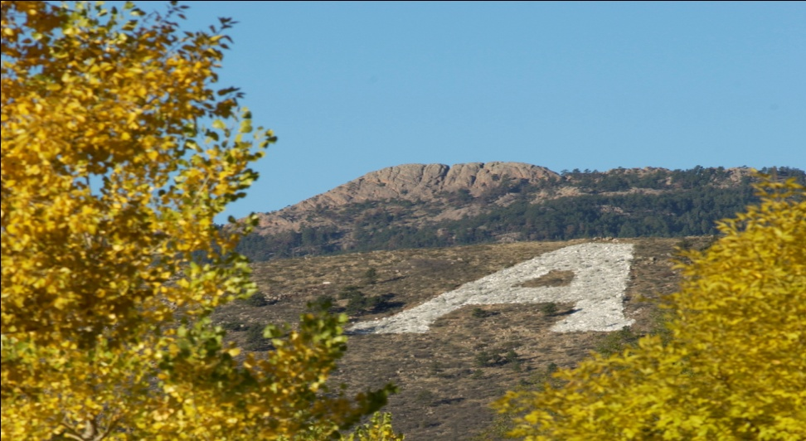
College of Agricultural Sciences (CAS)
CAS Departments:
Agricultural & Resource Economics
Animal Sciences
Horticulture & Landscape Architecture
Soil & Crop Sciences
Bioagricultural Sciences & Pest Management

Slide 5
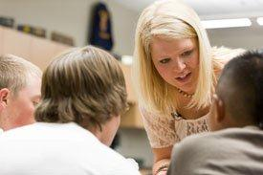
Agricultural & Resource Economics
Agricultural Education
- Teacher Preparation
- Ag Literacy
Agricultural Business
Agricultural Economics
- Agricultural Economics
- Farm & Ranch Management
- Natural Resource Economics

Slide 6
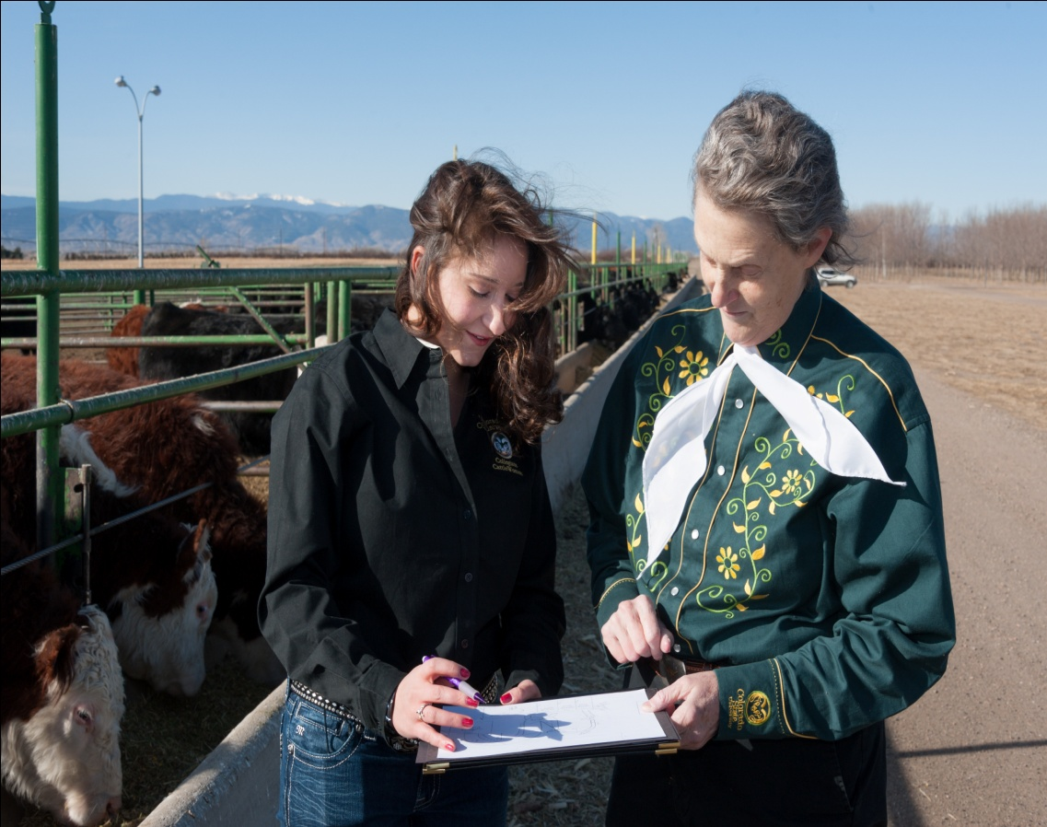
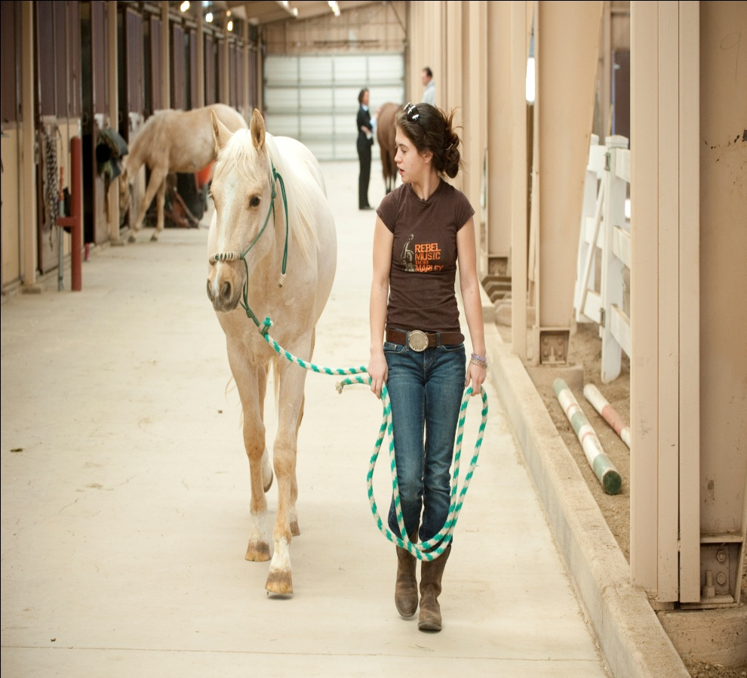
Animal Sciences
Animal Science
Equine Science

Slide 7
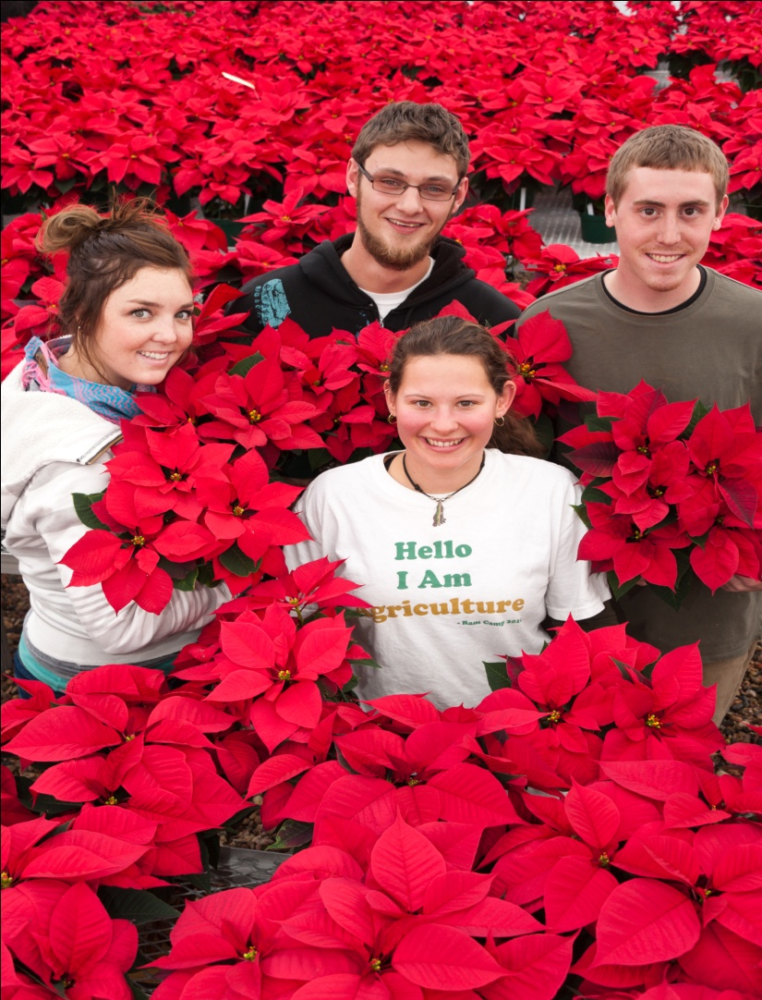
Horticulture & Landscape Architecture
Horticulture
- Floriculture
- Horticulture Business Mgmt.
- Horticulture Food Crops
- Horticultural Science
- Horticultural Therapy
- Viticulture & Enology

Slide 8
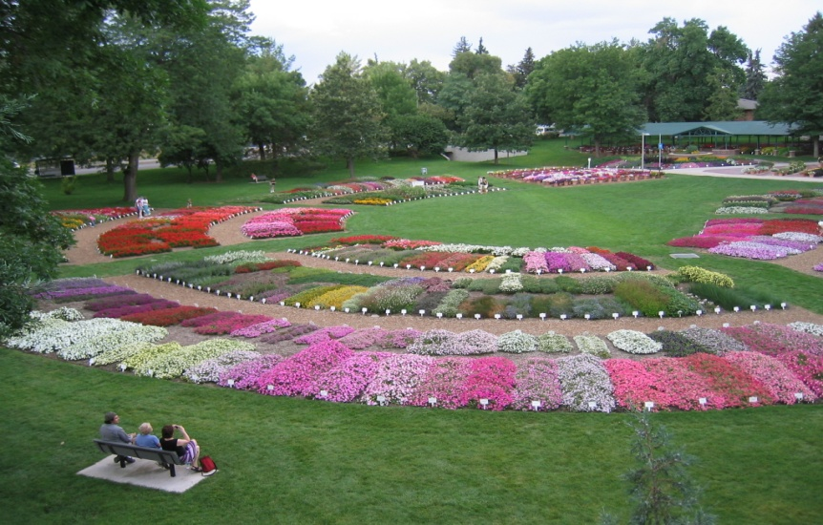
Horticulture & Landscape Architecture (cont.)
Environmental Horticulture
- Landscape Business
- Landscape Design & Contracting
- Nursery & Landscape Management
- Turf Management
Landscape Architecture

Slide 9
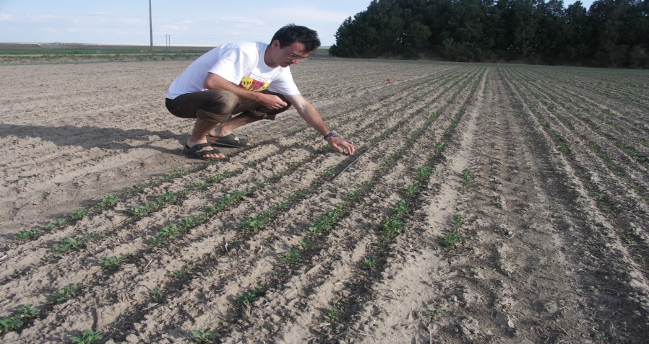
Soil & Crop Sciences
Agricultural Information Technologies
Agricultural Production Management
Biomass for Biofuels
International Soil & Crop Sciences
Plant Biotechnology, Genetics & Breeding
Soil Ecology
Soil Restoration & Conservation

Slide 10
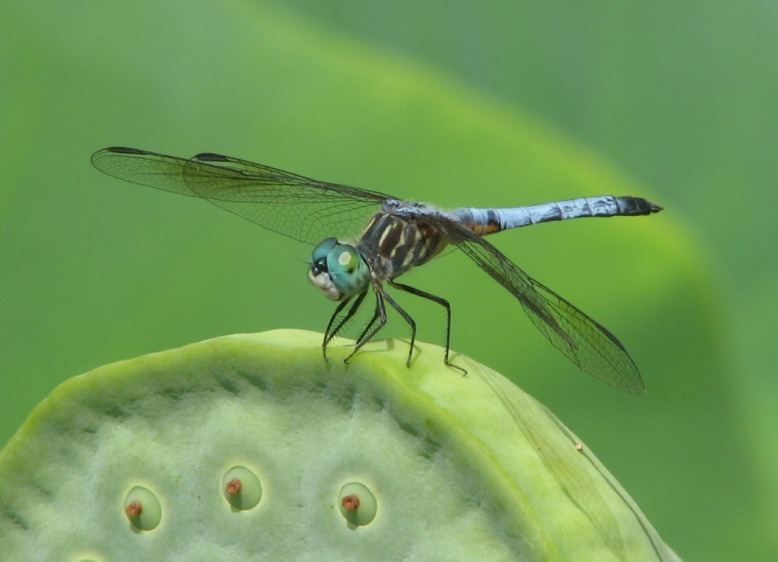
Bioagricultural Sciences & Pest Management (BSPM)
BSPM offers two minor options & a masters program
Entomology minor
Plant Health minor
4 + 1 masters

Slide 11
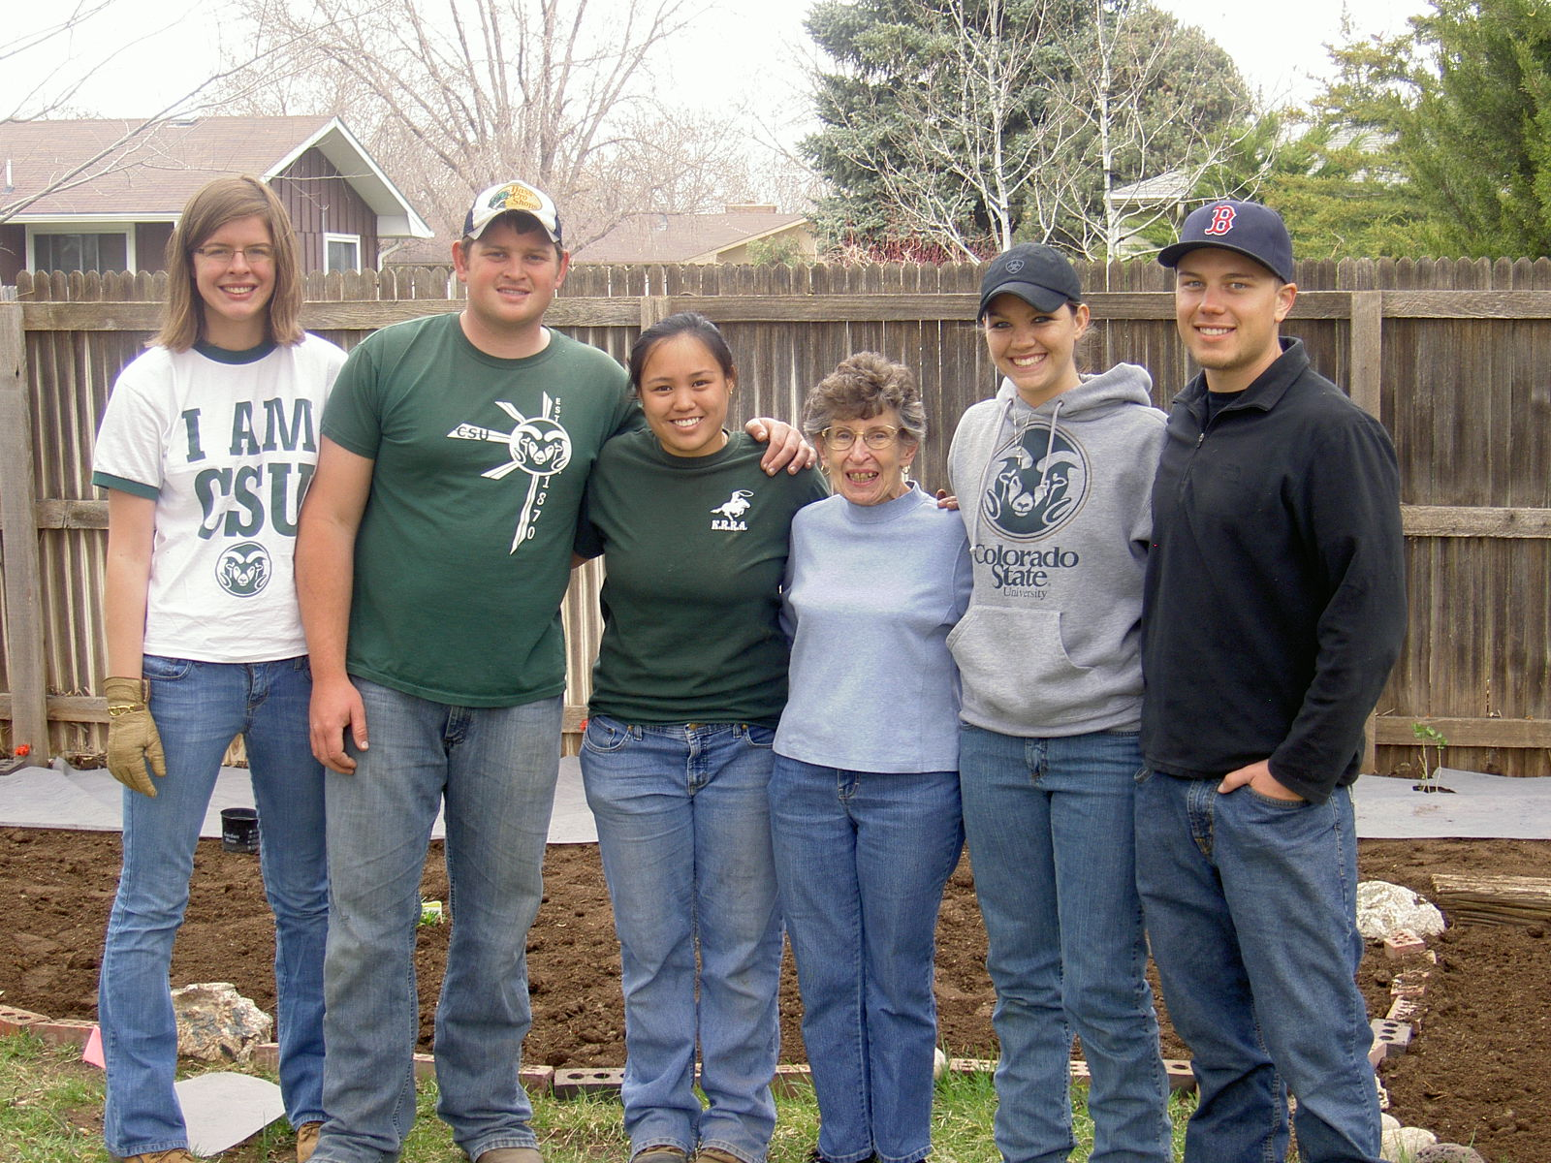
Student Organizations
Over 35 student organizations in CAS

Slide 12
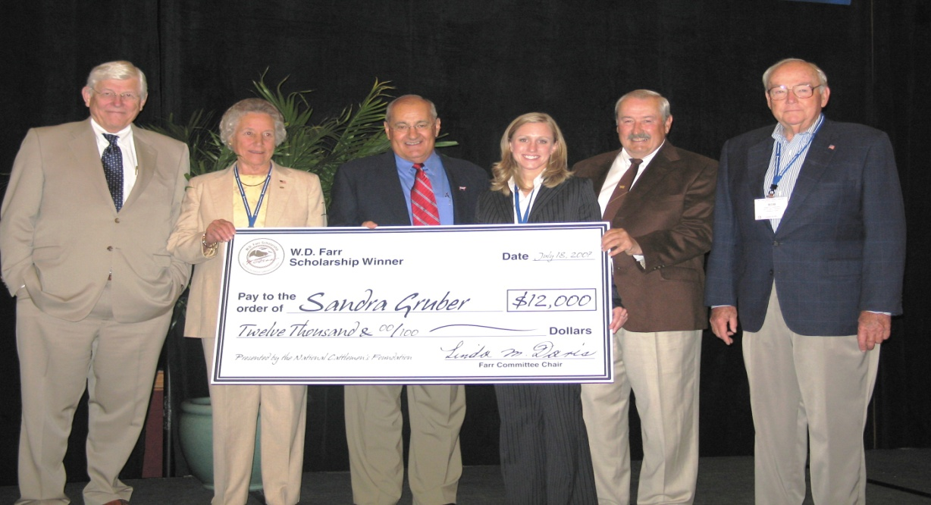
Scholarships
Over 400 scholarships were awarded for the 2014-15 academic year
More than $795,000 was awarded
More CAS scholarships awarded than any other College at CSU

Slide 13
How to Apply to CSU
CSU or Common Application
Transcript
Test Scores
Letter of Recommendation
Personal Statement
$50 Processing Fee

Slide 14
Visit CSU
University Information Session & Campus Tour
- Office of Admissions
- Monday-Friday, 9:00 a.m. & 2:00 p.m.
CAS Tour & Meetings
- Contact Ruben Flores
- Personalized Visitation Schedule

Slide 15
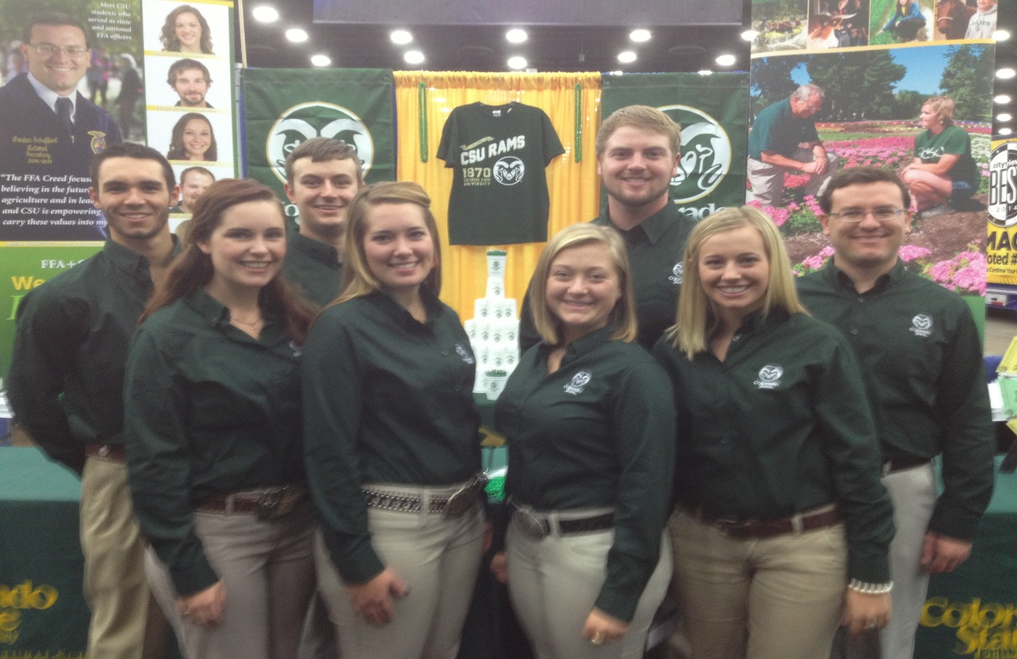
CAS will help you grow
National FFA Convention – Louisville, KY
Agricultural Future of America (AFA) – Kansas City, MO
Minorities in Agriculture, Natural Resources & Related Sciences – Houston, TX

Slide 16
Questions / CAS Contact Information
Questions?
ruben.flores@colostate.edu
970.391.0955
www.agsci.colostate.edu

